Slide 1
The Greeks
Beginning of the “Greeks”
Religion, Philosophy & History
Alexander the Great and the Hellenistic Age

Slide 2
Beginnings of the
“Greeks” (500 B.C.E.)
Polis
  Citizenship
  Spartan Military Oligarchy
    Rigid militarist state
    Government
      The Assembly (citizens over the age of 30)
      Council of Elders (28 men over the age of 60 elected for life)
      Two Kings (two men from the most important families in Sparta)
Athenian Limited Democracy
  Geographic Citizenship – Limited Democracy
  Government
    Assembly of Citizens (citizens 18 or older)
    Council of 500 (500 elected men)
    Board of 10 (10 chosen officials)
      archons

Slide 3
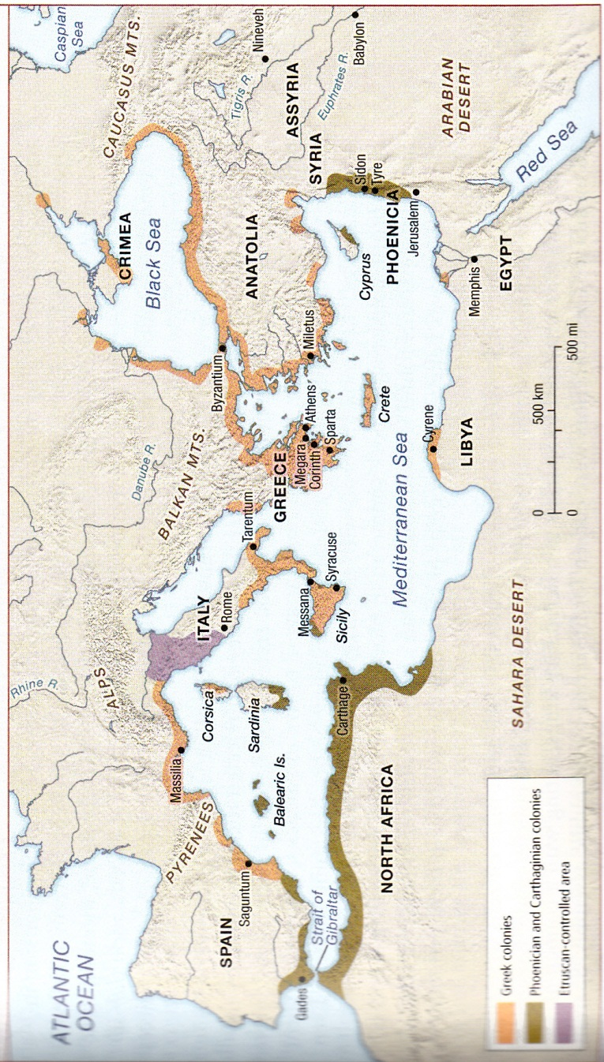

Slide 4
Religion, Philosophy & History
Religion
  Great Olympians – Zeus
    Elysian Fields
    Tartarus
    Asphodel Fields
Philosophy
  Plato (428-347 B.C.E)
    Republic
      Guardians
  Aristotle (384-322 B.C.E.)
    Empirical Approach
    Four Elements
History
  Thucydides
    History of The Peloponnesian War
      Sparta vs. Athens
      Book proposes that the war was over ideology

Slide 5
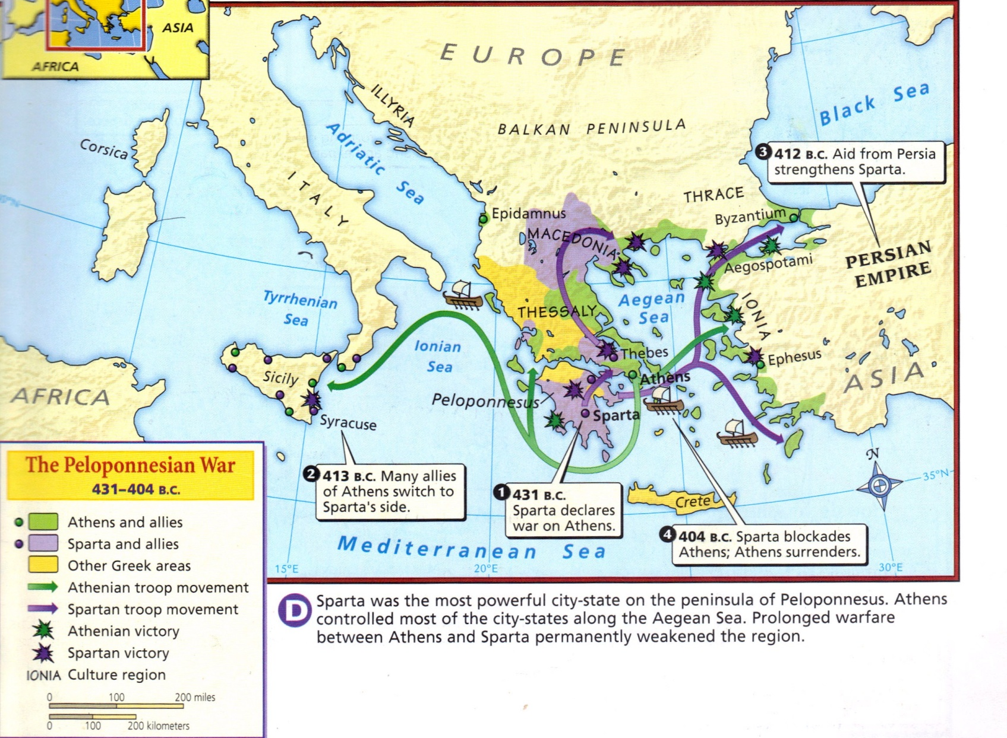

Slide 6
Alexander the Great and the Hellenistic Age
Alexander the Great (336-323 B.C.E.)
Hellenistic Age (323-21 B.C.E)
    Eratosthenes
      24,675 miles
    Claudius Ptolemy
      Earth centered view of the universe.

Slide 7
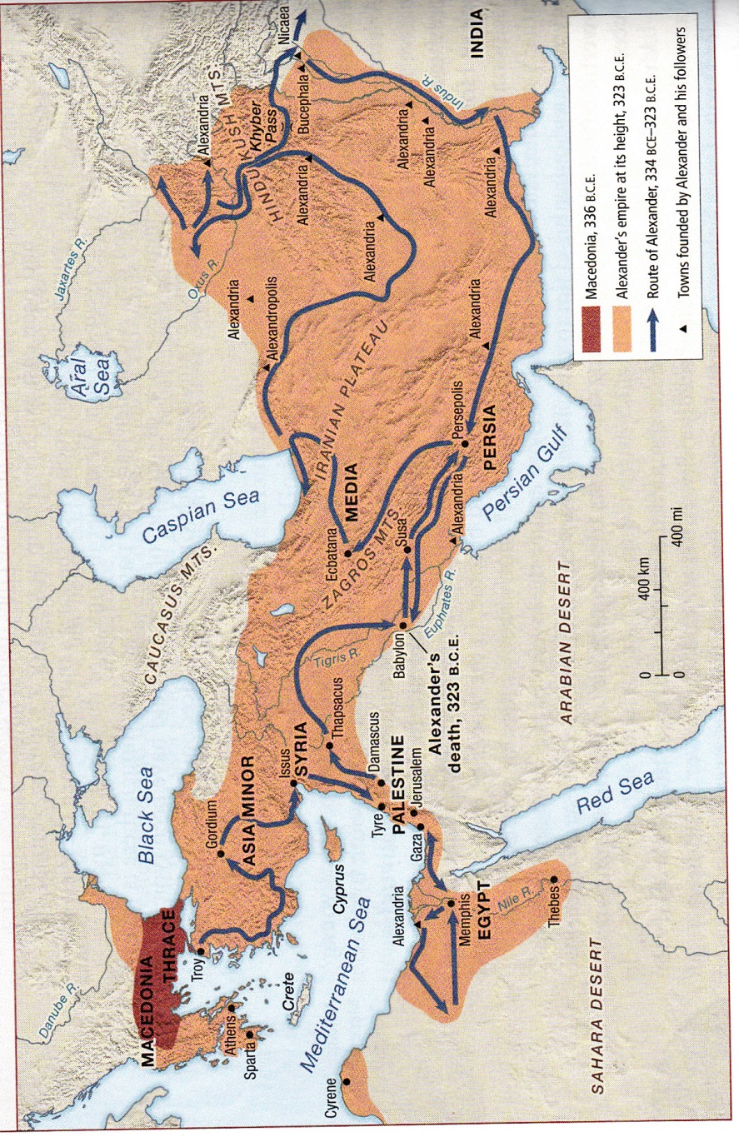

Slide 8
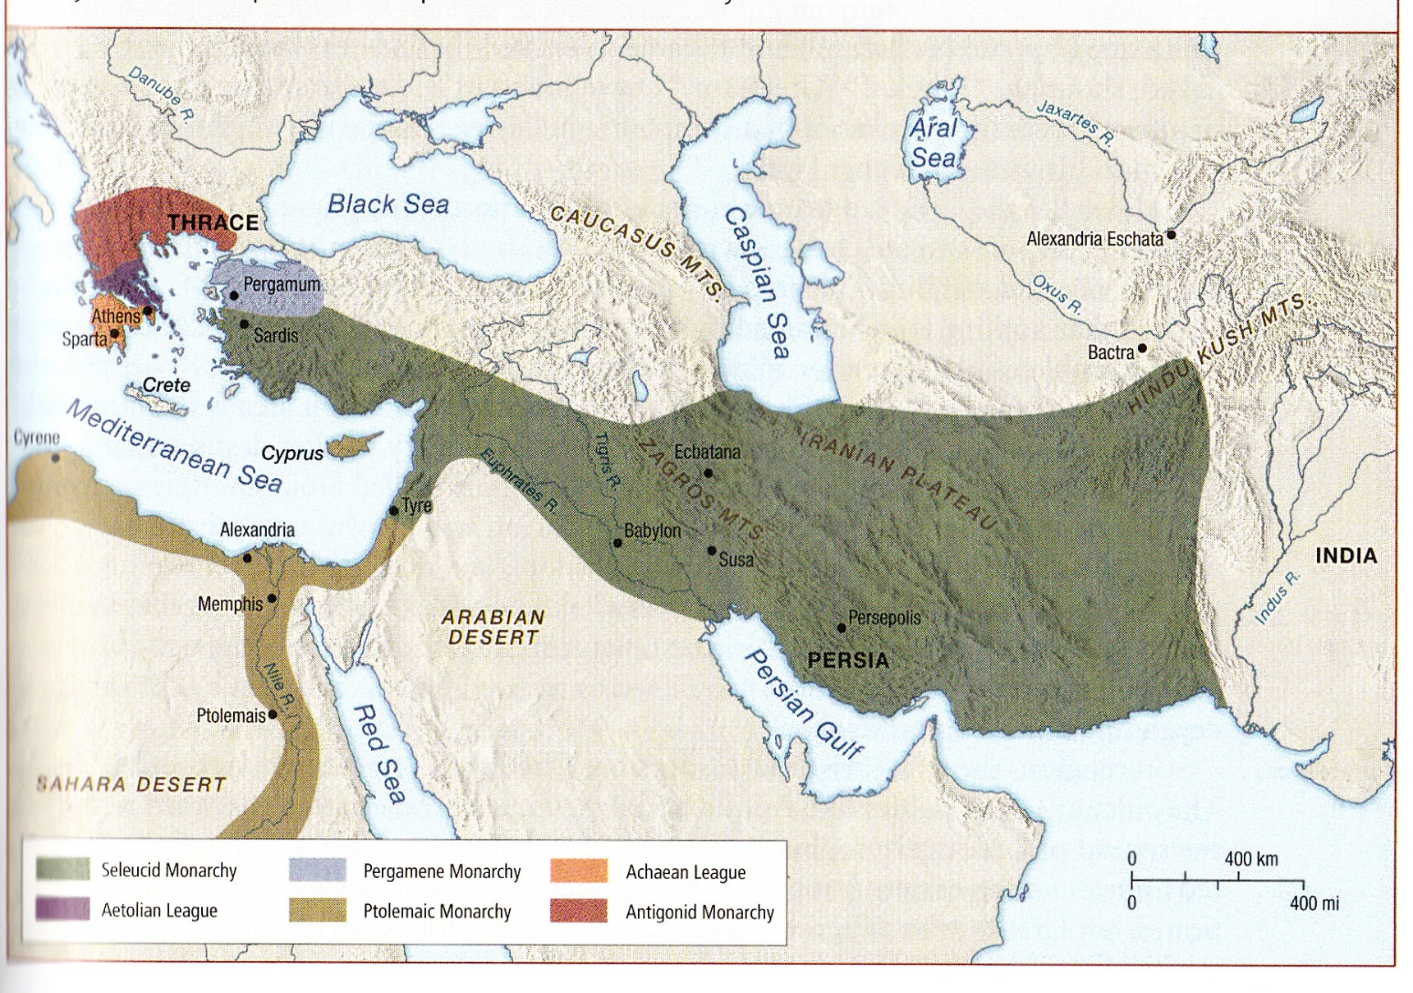

Slide 9
